Slide 1
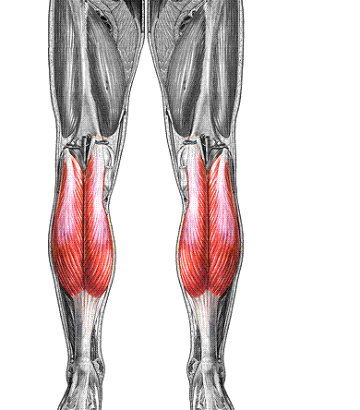
Gastrocnemius
O: femur
I: calcaneus
F: plantar flex foot,
flex knee

Slide 2
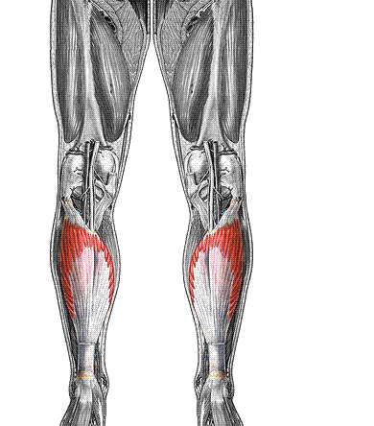
Soleus
O: tibia & fibula
I: calcaneus
F: plantar flex foot

Slide 3
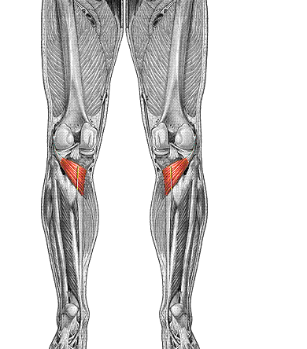
Popliteus
O: femur
I: tibia
F: flex, unlock knee

Slide 4
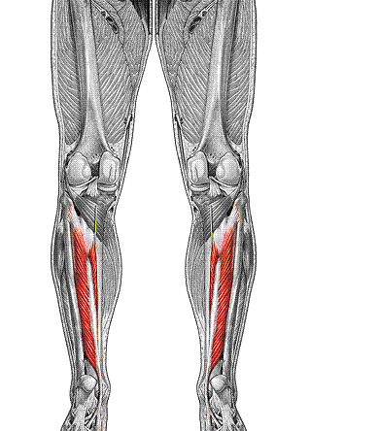
Tibialis posterior
O: tibia & fibula
I: tarsals & metatarsals
F: plantar flex, invert
foot

Slide 5
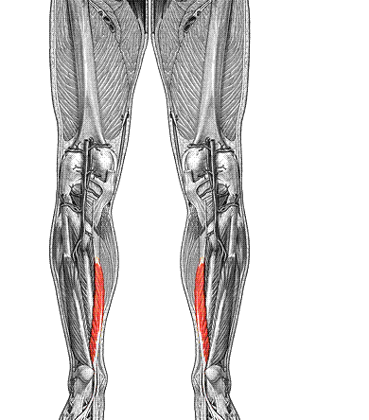
Flexor digitorum longus
O: tibia
I: distal phalanges 2-5
F: flexes toes,
plantar flex foot

Slide 6
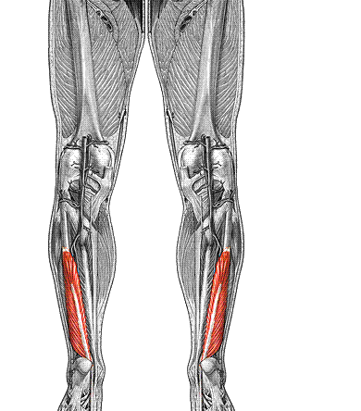
Flexor hallucis longus
O: fibula
I: distal phalanx of
big toe
F: flex big toe,
plantar flex foot

Slide 7
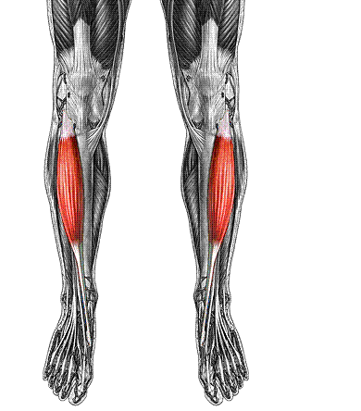
Tibialis anterior
O: tibia
I: tarsals & metatarsal 1
F: dorsiflex foot

Slide 8
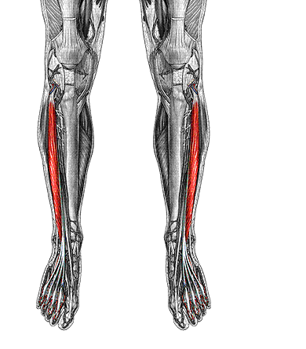
Extensor digitorum longus
O: tibia & fibula
I: mid, distal phalanges 2-5
F: extend toes, dorsiflex foot

Slide 9
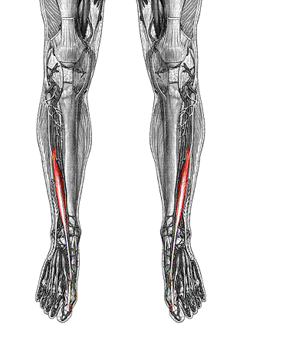
Extensor hallucis longus
O: fibula
I: distal phalanx of big toe
F: extend big toe, dorsiflex foot

Slide 10
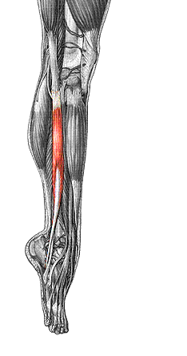
Peroneus longus
O: fibula
I: 1st metatarsal
F: plantar flex & evert foot

Slide 11
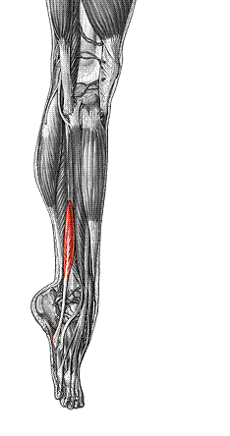
Peroneus brevis
O: fibula
I: 5th metatarsal
F: plantar flex & evert foot

